Slide 1
THEMATIC ROLES/Semantic Role/Theta role

Slide 2
Thematic Roles express the role that a noun phrase plays with respect to the action or state described by a governing verb.
THEMATIC ROLES basically indicate the semantic (i.e., meaning) relationship between the noun phrase and the verb in a sentence.

Slide 3
In other words, Thematic Roles tell us what “role” the NP plays in the action described by the verb in a sentence. The concept will, no doubt, become clearer as we consider several examples of thematic roles.
Some of the different thematic roles that seem to hold in many, if not all, language are shown in series 1) through 6). The NP that illustrates each thematic role is in italics. (Note that NP as used in this entry refers to “noun phrase”. See Noun Phrase

Slide 4
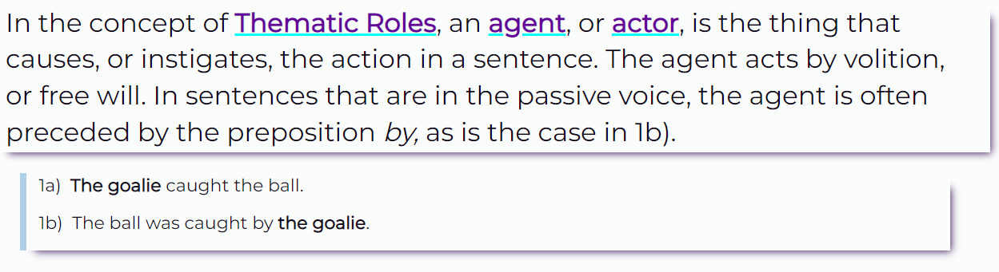

Slide 5
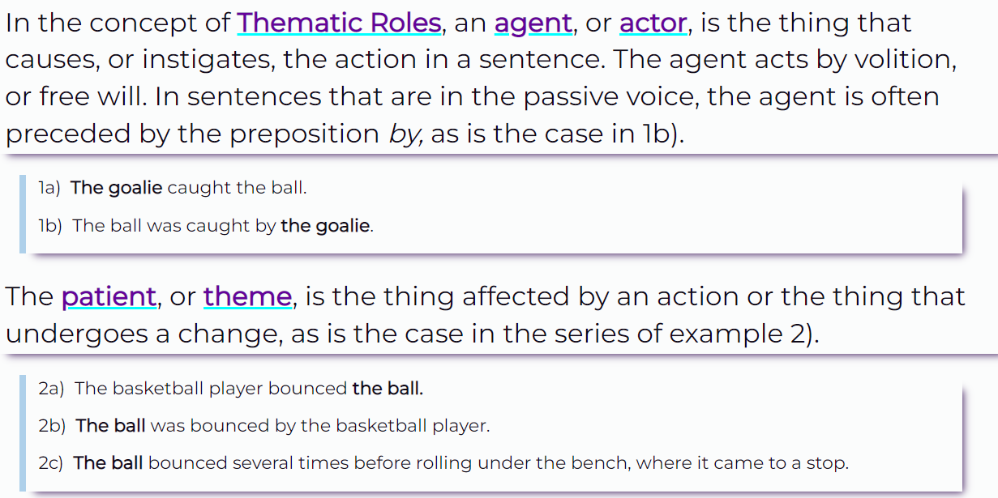

Slide 6
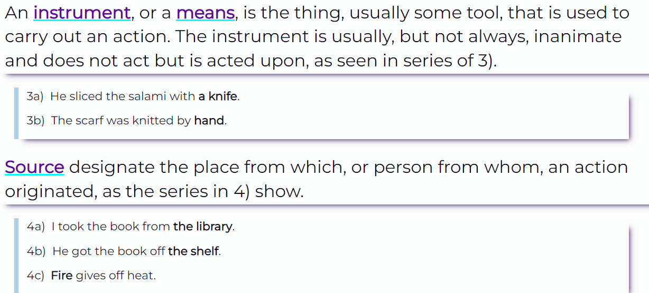

Slide 7
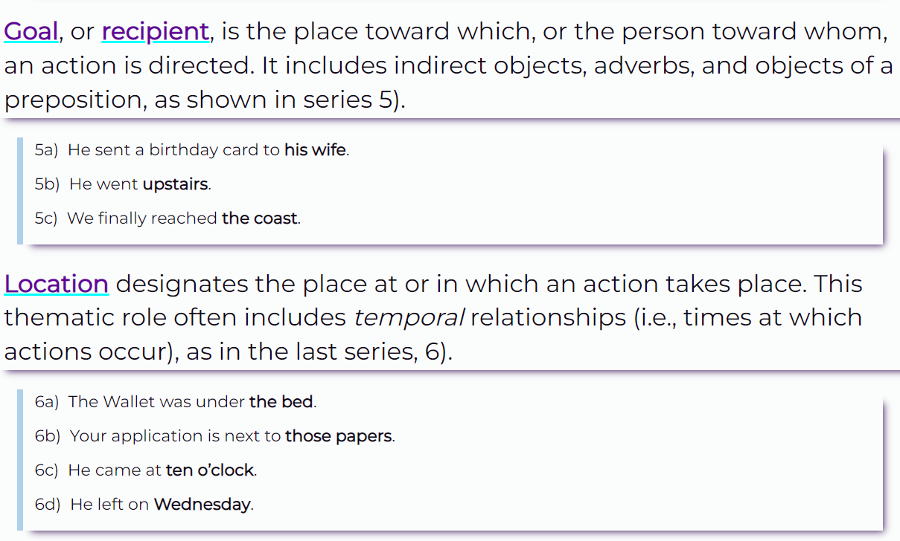

Slide 8
